Slide 1


Greater Essex Business Board: Member specification
By business, for business, with business

Slide 2
Welcome
Thank you for your interest in the Greater Essex Business Board (GEBB) – the strategic advisory board of business influencers brought together to advise, advocate, and lobby in the interests of Greater Essex.
This document provides background information on the GEBB, including:
The role and purpose of the GEBB;
The GEBB’s priorities;
How the Board operates; and
How to find out more.

Slide 3
The role and purpose of the GEBB
The GEBB is a strategic advisory board of business influencers – advising, advocating, and lobbying in the interests of Greater Essex. It brings together 19 influential and inspiring businesses, reflecting key sectors of the economy and geographical areas of Greater Essex. Board members work closely with officers from local authorities as well as existing regional and local networks, groups and forums to:
Influence decisions
Advocate for business
Deliver Impact
GEBB exists to influence economic growth policies at both the local and national level.
GEBB provides strategic advice to political decision-makers. It has the freedom and autonomy to set its own agenda, using evidence to develop, its own positions on key issues.
Its advice will help in setting the strategic direction for local economic policy, including producing and updating an Economic Strategy for Greater Essex.
GEBB provides the authoritative and authentic voice of business in Greater Essex, with the confidence to speak and be heard.
GEBB will develop robust mechanisms to engage with businesses across Greater Essex, listening, gathering intelligence and using this as a basis to inform its work with decision-makers.
GEBB will develop connections, with local, regional and national business networks. It will champion Greater Essex – helping it to stand out and compete.
GEBB will oversee activities that support Greater Essex business, including Growth Hub business support and skills programmes (with Essex Chamber of Commerce).
The GEBB will focus its attention on securing new investment in Greater Essex, supporting and advocating for
key growth sectors,
key sites;
vital infrastructure;
workforce skills

Slide 4

The GEBB’s priorities
Infrastructure for Growth
Improvements to rail, road and energy networks.
Unlock potential of ports and airports as global gateways.
Secure long‑term utilities investment to enable future developments (e.g., AI data centres).
Inward Investment
Build a strong Greater Essex identity and unified inward investment service.
Promote development opportunities and create investor‑ready “deal‑books.”
Establish an Investment Promotion Agency and Creative Enterprise Zones.
Skilled workforce
Ensure skills provision matches employer needs in key sectors.
Create a Greater Essex Skills & Innovation Fund.
Develop a single “One Essex Skills Front Door” for employers.
Embed local training outcomes into major investment projects.
Inward Investment
Simplify and unify the business support landscape.
Strengthen the Greater Essex Growth Hub.
Enable collaboration and innovation through new Innovation Centres.
Promote success stories and build a network of Business Ambassadors.

Slide 5
How the GEBB operates
The GEBB has been developed by business, for business with business. It has the necessary administrative and financial support to undertake its work. It will operates through working groups with expert support to follow-up on the direction set by the Board. The GEBB’s continued success will lie in its ability to convene partnerships, influence policy and to attract investment to Greater Essex.
The GEBB’s role is to…
The GEBB does not…
…convene business interests from across Greater Essex, the UK and across the globe to gain the best insight into local challenges and potential solutions.
…focus on outcomes and the action required to deliver them, rather than on formal meetings, process and paperwork.
…work in the open promoting transparency in to work to build support and momentum from across Greater Essex business.
…partner with those who have shared interests and can help influence decisions to the benefit of Essex businesses – whoever and wherever they may be.
…work to an agenda constrained by local councils
…simply rubber-stamp decisions that have already been taken;
…have lots of board meetings and spend time just receiving information
…duplicate the work of existing local business groups
…waste time and energy on issues where it cannot and secure impact;
….shy away from delivering difficult messages to those in power
…increase bureaucracy or act as a gatekeeper; or
…act in isolation.
OCT
JUL
AUG
SEP

Slide 6
Important information
We are looking to fill two vacant positions on the GEBB. We are seeking to appoint one new GEBB member from the Creative and Cultural sector. Our other new member will be appointed from the wider business community, but we would particularly welcome applications from those with experience in tech and AI, energy, financial services or in any other key growth sector within the Greater Essex economy.
All candidates should be prepared to commit to joining GEBB on that basis that:
the GEBB comes together around key activities and meets approximately four times a year;
the next GEBB meeting will take place on 11th June 2026;
board members act as ambassadors for Greater Essex Business. They will act in the interests of the business community and are active in promoting the voice of business from across the area;
board members draw upon their national, international, business and government connections to advance the interests of Greater Essex;
board members engage widely, gather intelligence from the local business community, and share this with elected leaders and policy-makers to inform investment priorities and growth enabling policies;
appointments to the Board will be made for a 1-year term in the first instance, allowing for flexibility and to reflect the changing local political and economic environment.

Slide 7
Personal specification: Board Member
We are seeking inspirational business leaders to provide the voice of business. As a GEBB member, you will:
share your perspective, expertise and experience to influence policy
stimulate economic growth, productivity and competitiveness
provide advice on the economy and local business landscape
adopt a strategic role, rather than pursuing the interest of your individual sector
We are looking for members who:
are influential and inspirational businesspeople with executive experience in business at a senior level or have experience in alternative entrepreneurial leadership roles;
have an understanding of, and a commitment towards, the growth, productivity and prosperity of the Greater Essex economy;
bring an exceptional knowledge and can act as ambassadors of their sector;
are passionate about improving the region and promoting it to national/international audiences, supporting investment activity;
are independent thinkers and can provide specialist, business-led insights to critically influence, shape and review economic development activity in Greater Essex;
are passionate about the Greater Essex regional economy and can act as advocates for the area and the opportunities offered for growth;
can demonstrate an inclusive, open and collaborative approach;
can work together to address challenges and opportunities, which will deliver transformative change for the Greater Essex economy

Slide 8
Wider characteristics – Board Members
Board members should:
be committed to promoting equality, diversity and ethical business practices and be environmentally considerate
be willing, committed and prepared to positively collaborate
bring their own experience, expertise and insight to bear (as opposed to pursuing individual and/or organisational interests) to ensure actions are delivered
adhere to high standards of behaviour and not bring the business board into disrepute – adhering to the Nolan Standards in Public Life and wider Board policies
be responsible and professional in their communications regarding their work on the Board (including social media and/or speaking opportunities)
maintain strict confidentiality and privacy regarding any commercially sensitive content
be respectful of others’ views

Slide 9
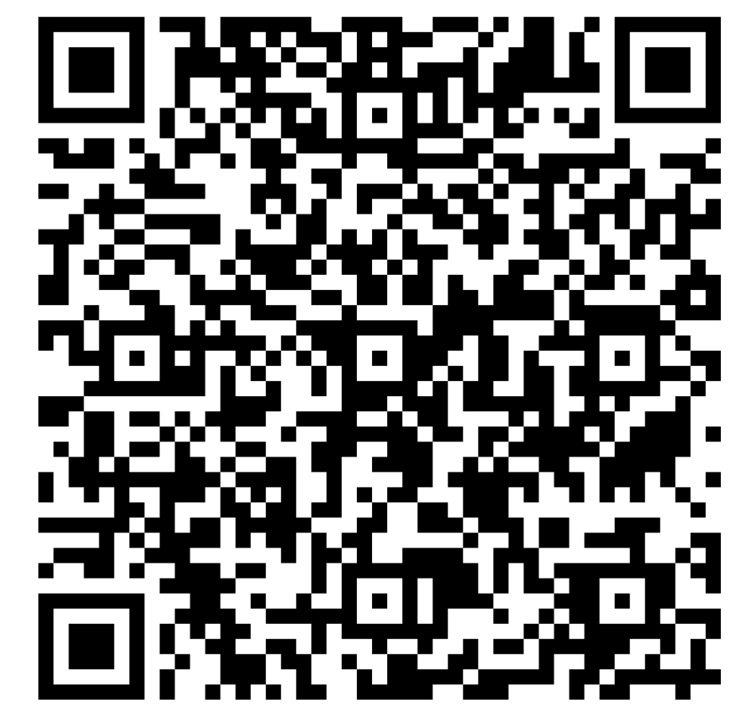
Expressions of interest
To discuss the role, please get in touch at business.board@essex.gov.uk to organise a call.
If you would like to serve as a member of the GEBB, please email business.board@essex.gov.uk with a CV and statement setting out how you meet the criteria set out in the specification and what you bring to the role.
Please apply by 5:00pm on 25th March 2026.
Applications will be considered by a selection panel consisting of existing GEBB members and elected political leaders.
Please note:
We value diversity and inclusion and welcome applications from candidates with diverse backgrounds
This is a non-renumerated role
You will be expected to commit two days per month to Board activities
This is a one-year position from point of appointment with the option to extend
Scan to apply

Slide 10

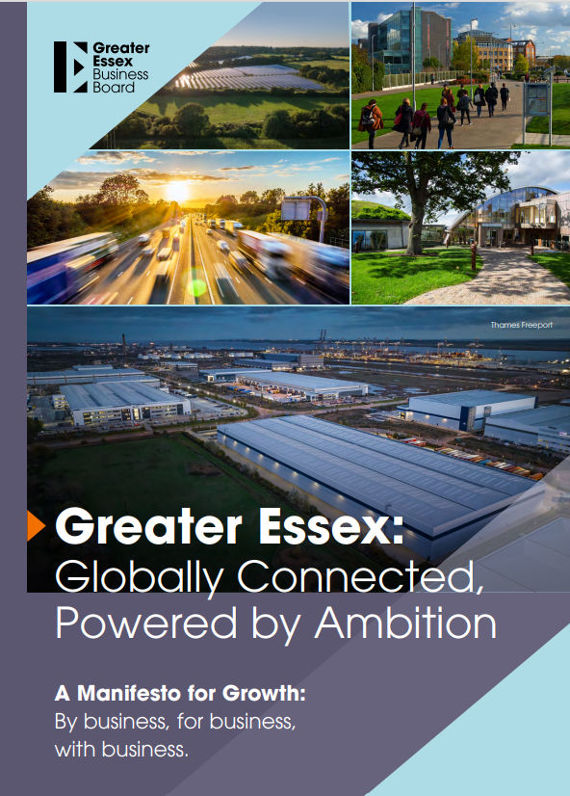
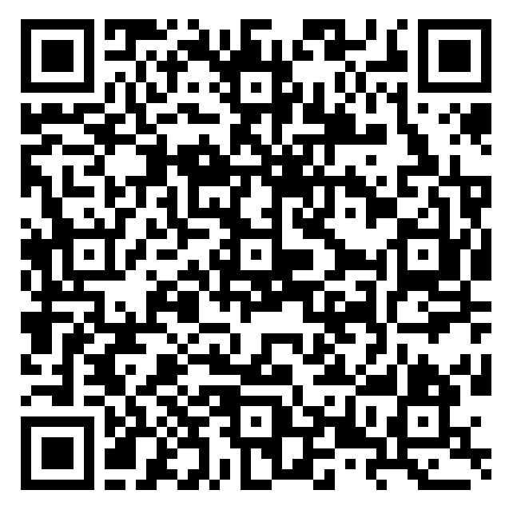
Scan to view the
Manifesto
Follow GEBB on LinkedIn Email business.board@essex.gov.uk

