Slide 1


Greater Essex Business Board: Information pack
By business, for business, with business

Slide 2
Welcome
Thank you for your interest in the Greater Essex Business Board (GEBB) – the strategic advisory board of business influencers brought together to advise, advocate, and lobby in the interests of Greater Essex.
This document provides background information on the GEBB, including:
The role and purpose of the GEBB;
The GEBB’s priorities;
How the Board operates; and
How to find out more.

Slide 3
The role and purpose of the GEBB
The GEBB is a strategic advisory board of business influencers – advising, advocating, and lobbying in the interests of Greater Essex. It brings together 10-15 influential and inspiring businesses, reflecting key sectors of the economy and geographical areas of Greater Essex. Board members work closely with officers from local authorities as well as existing regional and local networks, groups and forums to:
Influence decisions
Advocate for business
Deliver Impact
GEBB exists to influence economic growth policies at both the local and national level.
GEBB provides strategic advice to political decision-makers. It has the freedom and autonomy to set its own agenda, using evidence to develop, its own positions on key issues.
Its advice will help in setting the strategic direction for local economic policy, including producing and updating an Economic Strategy for Greater Essex.
GEBB provides the authoritative and authentic voice of business in Greater Essex, with the confidence to speak and be heard.
GEBB will develop robust mechanisms to engage with businesses across Greater Essex, listening, gathering intelligence and using this as a basis to inform its work with decision-makers.
GEBB will develop connections, with local, regional and national business networks. It will champion Greater Essex – helping it to stand out and compete.
GEBB will oversee activities that support Greater Essex business, including Growth Hub business support and skills programmes (with Essex Chamber of Commerce).
The GEBB will focus its attention on securing new investment in Greater Essex, supporting and advocating for
key growth sectors,
key sites;
vital infrastructure;
workforce skills

Slide 4

The GEBB’s priorities
Infrastructure for Growth
Improvements to rail, road and energy networks.
Unlock potential of ports and airports as global gateways.
Secure long‑term utilities investment to enable future developments (e.g., AI data centres).
Inward Investment
Build a strong Greater Essex identity and unified inward investment service.
Promote development opportunities and create investor‑ready “deal‑books.”
Establish an Investment Promotion Agency and Creative Enterprise Zones.
Skilled workforce
Ensure skills provision matches employer needs in key sectors.
Create a Greater Essex Skills & Innovation Fund.
Develop a single “One Essex Skills Front Door” for employers.
Embed local training outcomes into major investment projects.
Inward Investment
Simplify and unify the business support landscape.
Strengthen the Greater Essex Growth Hub.
Enable collaboration and innovation through new Innovation Centres.
Promote success stories and build a network of Business Ambassadors.

Slide 5
How the GEBB operates
The GEBB has been developed by business, for business with business. It has the necessary administrative and financial support to undertake its work. It will operates through working groups with expert support to follow-up on the direction set by the Board. The GEBB’s continued success will lie in its ability to convene partnerships, influence policy and to attract investment to Greater Essex.
The GEBB’s role is to…
The GEBB does not…
…convene business interests from across Greater Essex, the UK and across the globe to gain the best insight into local challenges and potential solutions.
…focus on outcomes and the action required to deliver them, rather than on formal meetings, process and paperwork.
…work in the open promoting transparency in to work to build support and momentum from across Greater Essex business.
…partner with those who have shared interests and can help influence decisions to the benefit of Essex businesses – whoever and wherever they may be.
…work to an agenda constrained by local councils
…simply rubber-stamp decisions that have already been taken;
…have lots of board meetings and spend time just receiving information
…duplicate the work of existing local business groups
…waste time and energy on issues where it cannot and secure impact;
….shy away from delivering difficult messages to those in power
…increase bureaucracy or act as a gatekeeper; or
…act in isolation.
OCT
JUL
AUG
SEP

Slide 6
Important information
We are seeking high-calibre members prepared to commit to the GEBB on that basis that:
the GEBB comes together around key activities and meets approximately four times a year;
the next GEBB meeting will take place in June 2026;
board members act as ambassadors for Greater Essex Business. They will act in the interests of the business community and are active in promoting the voice of business from across the area;
board members draw upon their national, international, business and government connections to advance the interests of Greater Essex;
board members engage widely, gather intelligence from the local business community, and share this with elected leaders and policy-makers to inform investment priorities and growth enabling policies;
appointments to the Board will be made for a 1-year term in the first instance, allowing for flexibility and to reflect the changing local political and economic environment.

Slide 7
Find out more
For anyone who is interested in joining the Greater Essex Business Board please read the Member specification documents.
Please apply by 5:00pm on 25th March 2025.
Applications will be considered by a selection panel consisting of existing GEBB Members and elected political leaders.
For any queries please contact: business.board@essex.gov.uk
Stay up to date via: [insert link to GEBB Linkedin]

Slide 8


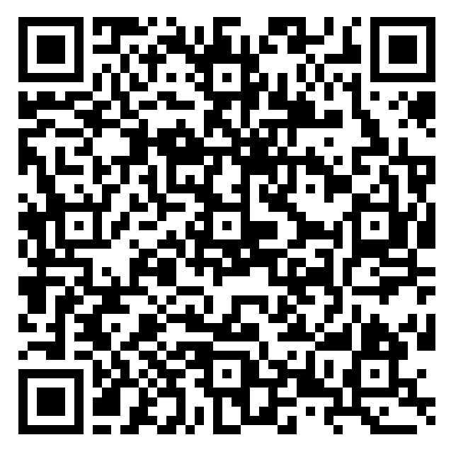
Scan to view the
Manifesto
Follow GEBB on LinkedIn Email business.board@essex.gov.uk

